Slide 1
Sleepless Nights? A data-driven Prediction of Sleep Disorders
Data Science Team 2
Sezin Dogan,Jacquelyne Sonda
22.03.2025

Slide 2
Agenda
2. Dataset Overview
3. Objective and Project Outline
Facts & Problem Statement
4. Results
5. Challenge
6.
Learnings & Solutions

Slide 3
Why this matters!
Problem Statement: A third of our lives is spent sleeping or at least we should. Sleep Disorder has been a major setback leading to reduced productivity, increased healthcare costs and deteriorating mental or physical health. This project seeks to address the gap by utilizing data driven insights to predict sleep disorders on measurable attributes.
https://www.singlecare.com/blog/news/sleep-statistics/

Slide 4
Dataset Overview
Dataset Size: 374 records with 13 Variables
Key Features: Age, Gender, BMI Category, Sleep Duration, Quality of Sleep, Physical Activity Level, Stress Level, Heart Rate, Blood Pressure, Daily Steps.
Libraries: Pandas, Numpy, sklearn for machine learning, Matplotlib.pyplot and seaborn for graphs and charts, plotly.express and plotly.graph_objs for interactive visuals and machine learning models

Slide 5
Our Objectives
Develop a machine learning based solution to predict sleep disorders using Health and lifestyle data
Provide actionable insights for healthcare providers and wellness businesses to improve outcomes.

Slide 6
Project Outline
Phase 1
Phase 2
Phase 3
Phase 4
Phase 5
Phase 6
Planning and Scope Definition
Defining of objectives and documenting the ways of working
Results: to ensure clarity and expected outcomes
Data Acquisition
Collected the relevant dataset using kaggle as a source
https://www.kaggle.com/datasets/uom190346a/sleep-health-and-lifestyle-dataset/data
Exploratory Data Analysis
Exploration of the data (shape, head, describe..)
Dropping irrerevant colunms
Handling missing values
Data Visualization
Distribution of variables using Numerical variables
Boxplots to summarize the numerical data by showing minimum, max, median and potential outliers
Model Development
Encoding Categorical values
Splitting the dataset
Train and evaluate multiple models: (Random Forest, Logistic Regression)
Best Model: Random Forest with (93% accuracy).
Feature Importance
Random Forest highlights: Blood pressure, BMI category, and age are important

Slide 7
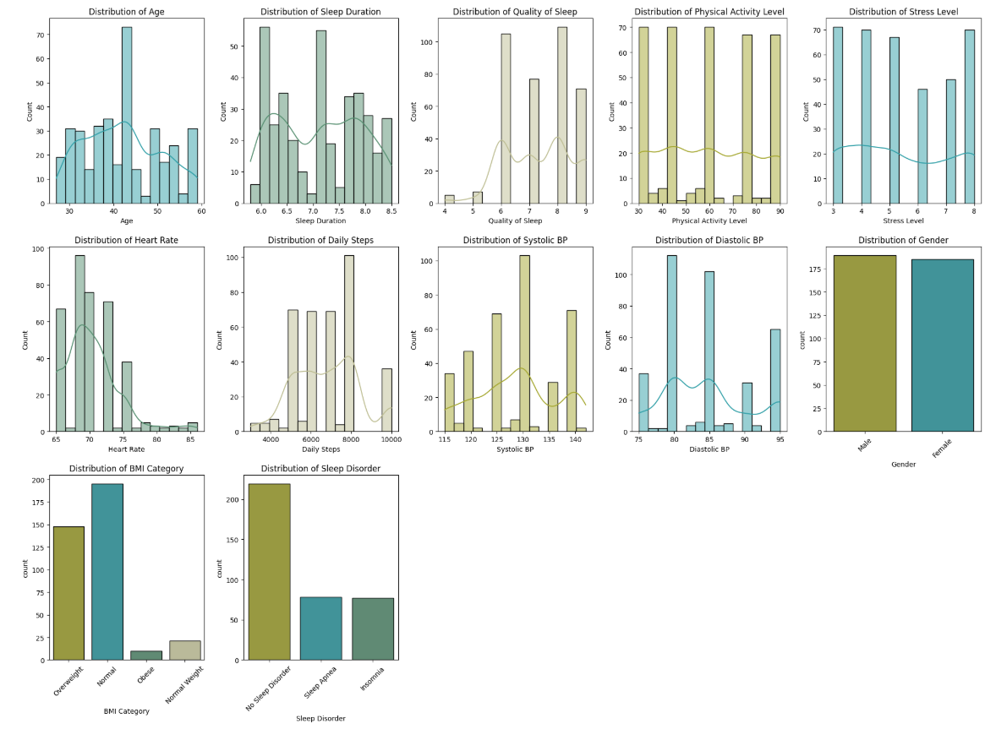
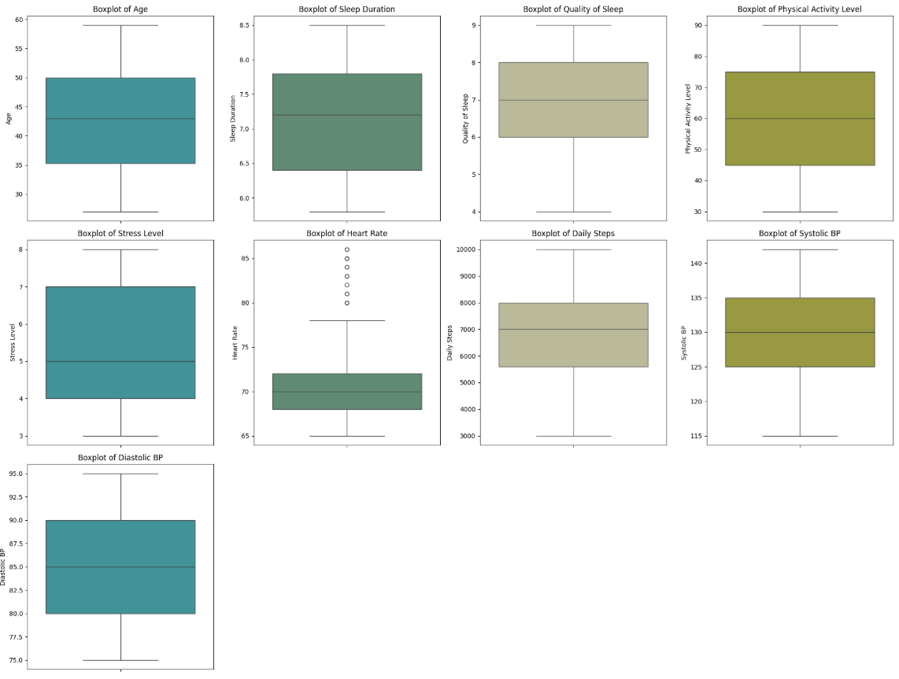
Original Dataset Results
EDA
Histograms and BoxPlots

Slide 8
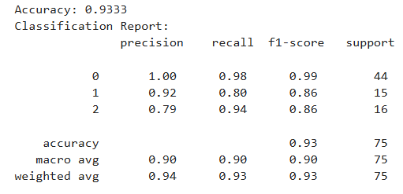
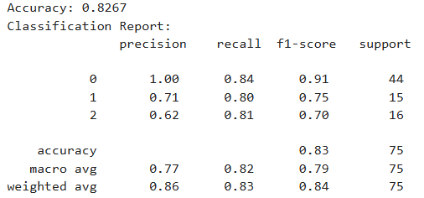
Machine Learning Models Results
Random Forest and Linear Regression
Accuracy 93 %
Accuracy 83 %
Logistic Regression
Random Forest
Class
Class
Class

Slide 9
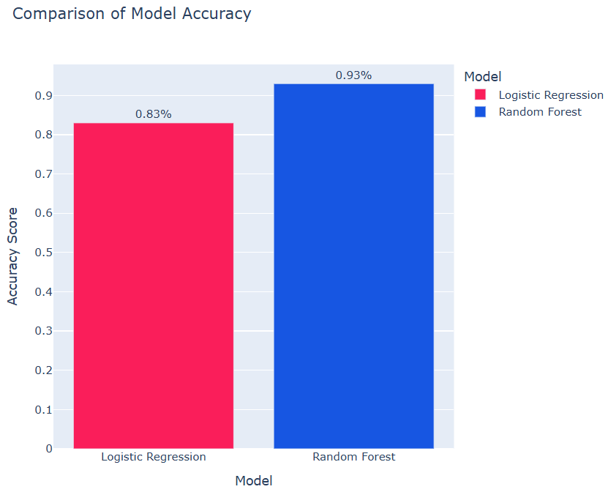
B. Comparison of Model Accuracy

Slide 10
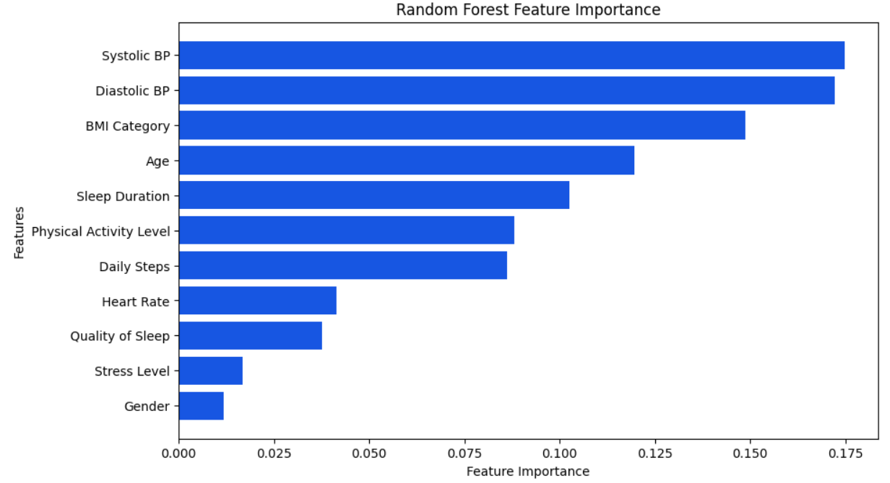
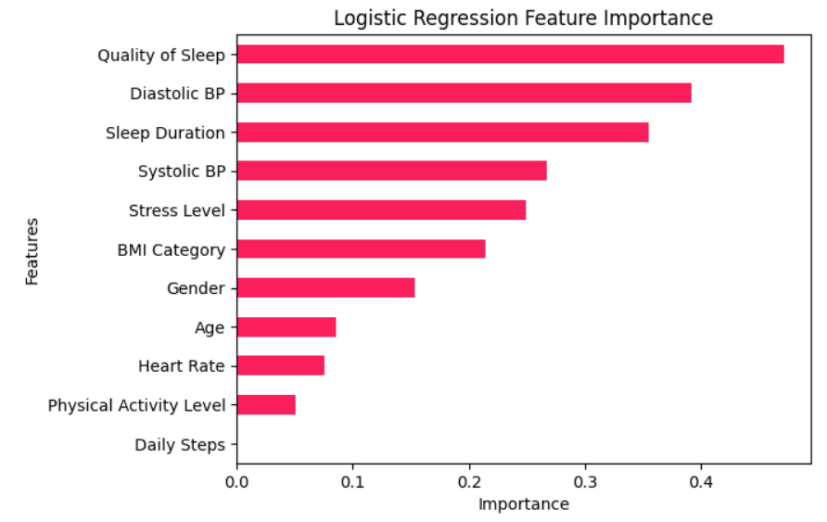
C. Feature Importance

Slide 11
Not so fast! There is a challenge..
Since the dataset entries are only 400 records, posing a challenge for a techie to have a viable learning ground during comprehensive analysis, uncovering patterns and machine learning application, what can be done?

Slide 12
Researched Solution
Generating Synthetic Data using AI from
374 entries
100,000 entries

Slide 13
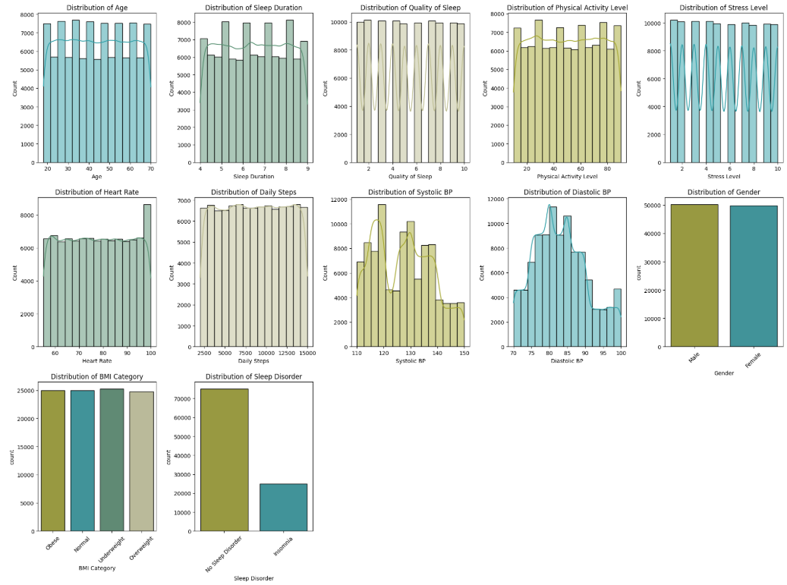
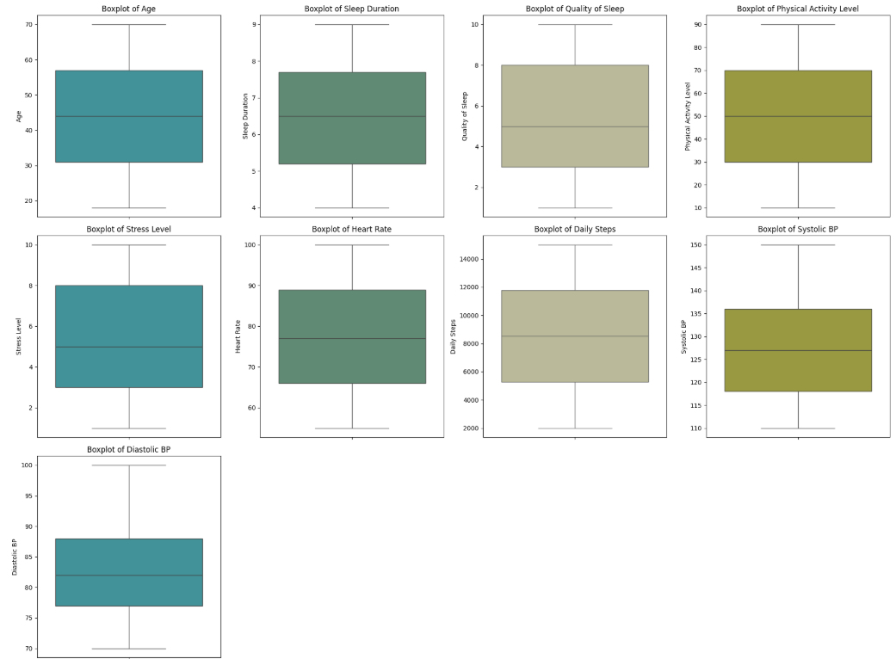
Synthetic Dataset Results
EDA Histograms & Boxplots

Slide 14
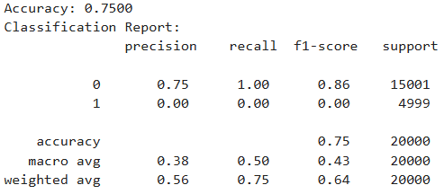
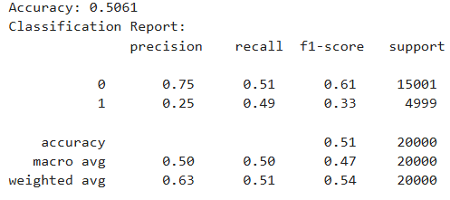
Machine Learning Models Results
Random Forest and Linear Regression
Accuracy 75 %
Accuracy 51 %
Logistic Regression
Random Forest

Slide 15
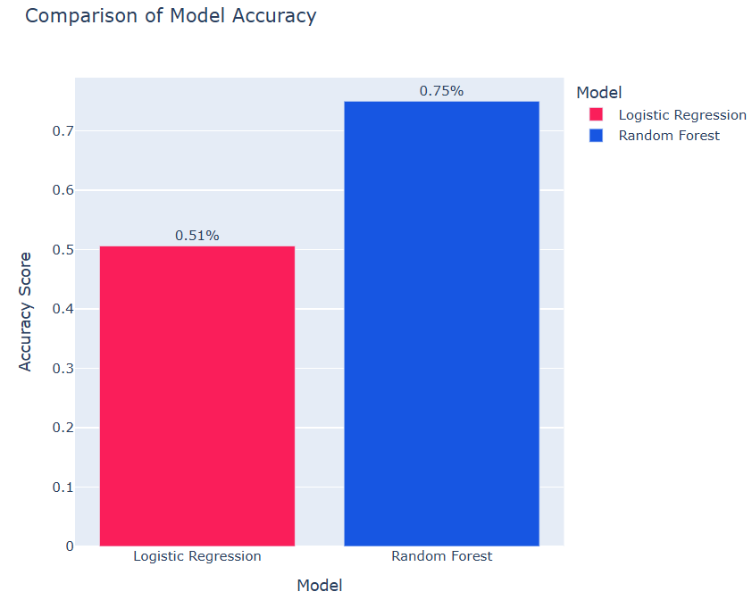
B. Comparison of Model Accuracy

Slide 16
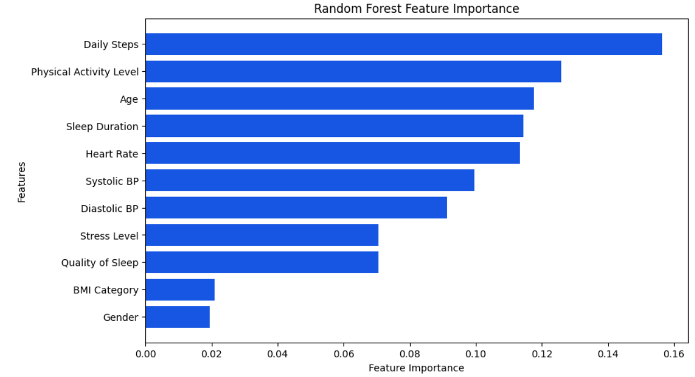
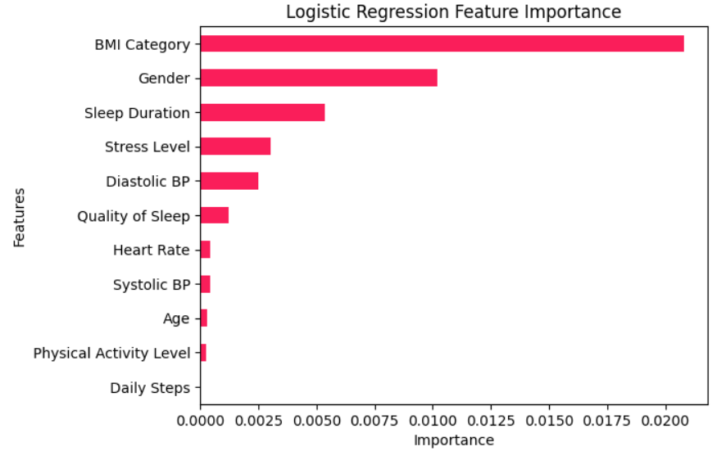
C. Feature Importance

Slide 17
Learnings
Technical Learnings
Data handling, preprocessing and evaluation: Handling big data using multiple packages
Machine learning workflow: Model evaluation using metrics such as accuracy, precision, recall, F1-score and confusion matrix
Personal Learnings
Adaptability Managing unexpected changes during the project phase
Patience and Perseverance: Handling messy data and knowledge sharing.
Stress management
Communication Skills
General thoughts and Expectations
Issue: Dataset research was harder than expected
Solution: Mentor Support was a key success and collaboration
Future Expectation: Apply the knowledge and skills that we acquired in future projects

Slide 18
Thank you for your attention!
Sezin Dogan and Jacquelyne Sonda
Data Science Track Team 2
22.03.2025

Slide 19
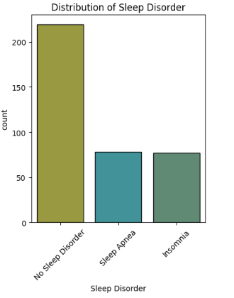
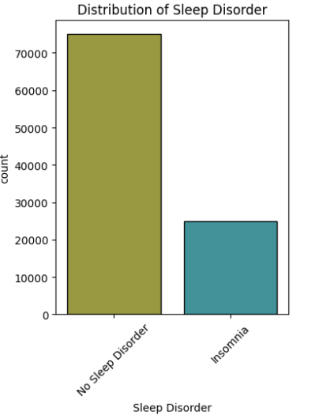
Back-up Slide: Distribution of Sleep Disorder
Original Data
Synthetic Data

